Slide 1
AMAZON SALES
DATA ANALYSIS REPORT
Yash Shinde

Slide 2
Problem Statement
Objective
Benefits
Help out to make better business decisions.
Help analyze customer trends and satisfaction, which can lead to new and better products and services.
Gives better insight of customers base.
Helps in easy flow for managing resources.
Sales management has gained importance to meet increasing competition and the need
for improved methods of distribution to reduce cost and to increase profits. Sales
management today is the most important function in a commercial and business
enterprise.
Develop a Report by Extracting-Transforming-Loading of data which contains Sales trend with respect to Year, Month, Quarter and find Some relationships through data to understand and Analyze the Facts.

Slide 3
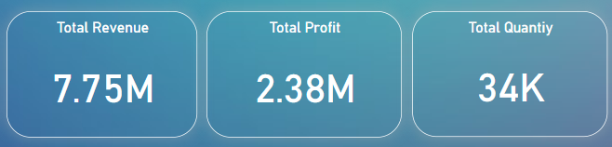
Quick Insight

Slide 4
Total Sales for year and months

Slide 5
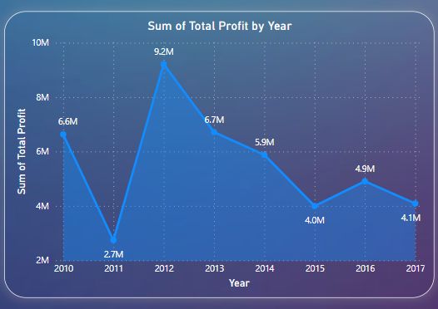
Yearly Sales Comparison

Slide 6
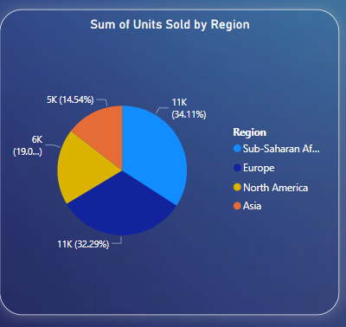
Quantity By Countries
﻿

Slide 7
Conclusion
1. 2017 had the highest Revenue at 85.12M, followed by 2019 at 76.12 and 2018 at 20.36M
2. If we observe the monthly insights of 2017,2018,2019, the sales are at their peak in March, June, and September and are low in April, May & October. Amazon can come up with some good discounts and offers to generate high revenue.
3. The sales for the US are highest among all countries and lowest in Iran (IR).
4. The Better Large Canned Shrimp & High Top Dried Mushrooms are the highest selling products in domestic and international markets.

